Slide 1
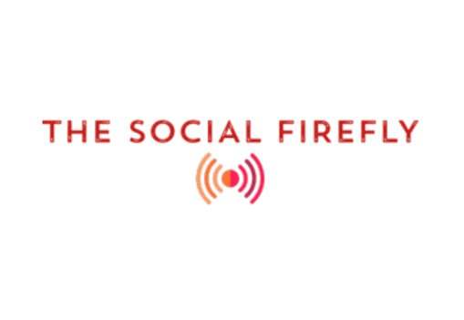
I-Corps Deck Pitch

Slide 2


Members
Alexander Mamishev, Project Supervisor,
Professor at University of Washington ECE
Yijie Li,
Team Leader,
Senior in Electrical Engineering at University of Washington
Place holder
Place holder

Slide 3
Problem:
Difficult to maintain social distancing with loosen restrictions
Communities with low vaccination rate
Customers:
People want their masks off but are still apprehensive about distance with others
Public venues like museums, gyms, cinemas, hall, classroom, etc.
Workspaces that physical divider is not possible like studios

Slide 4

Solution
A wearable device that
alerts the user when a human is within a customizable range
uses thermal camera and TOF distance sensor
does not have CV capabilities to reduce cyber safety concern
has a small form factor
is easy and cheap to manufacture
is highly customizable to adjust to different use cases

Slide 5
Value Proposition
Easily attachable and detachable for bulk and temporary distribution
Alerts users and surrounding people to maintain distance
Allowing indoor activities with minimum distance concerns like spreading the virus
Indoor facilities like museums can increase visitor capacity
Cheap when purchased in bulk

Slide 6
Market Size
Museums:
35,000 museums in the US​
850 million visits a year​
Market Size of 12.19 billion USD​
94,770 employees in Museum industry in the U.S
Premiere League:
20 teams, 20 stadiums
14,511,485 total attendances in 18/19 season (pre-covid)
With and average ticket price of 43.55 GBP, the total market for all teams is around 875 million USD
Public libraries
9,057 public libraries out of 116,867 total number of libraries that includes schools, academic,
government and more
In 2016, 171 million registered users with 1.36 billion library visits
Market size in 2021 is 18.9 billion USD.
136,851 employees in public libraries out of 366,642 total employees
that include other types of libraries(school, government etc.)

Slide 7
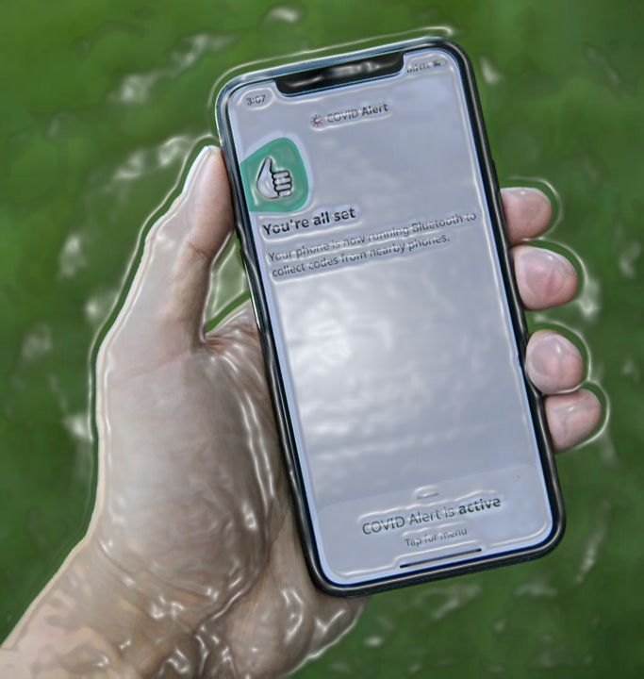
Competition
Leading alternatives are
Kinexon Sensors and IOS/Android built in covid alert.
But they
require Bluetooth to identify nearby devices, rising cyber security concerns;
cannot be used cross platform;
requires manual input.
So, we
developed our device that prioritized individual usage and safety.

Slide 8

Customer Discovery results
~25 interviews conducted
Insights gained
Uncomfortable confronting others
Apprehensive about crowded indoor spaces
Unwilling to spend a lot on similar devices
TBD

Slide 9
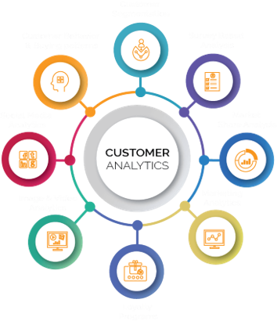
Need For & Use of I-Corps Funding
After the prototype is done with Arduino, we will migrate the system to a custom PCB, the funding can be used to manufacture multiple iterations for testing purpose.
Some sensors are defective and cannot be calibrated to meet our requirement, the funding can be used to bulk purchase sensors.
Once public venues like museums agreed to deploy our device, we need to produce enough devices, the funding can be used to cover the cost before payment arrives.
After the first generation is in use, the funding can be used for further research like customer exploration and sensor development

Slide 10
Conclusion
Covid is ending but not for everyone, with many people from different communities still apprehensive about others not wearing a mask in public spaces, our product can fit into such market.
As future remains unpredictable, chances are there could be another pandemic or similar emergency.
To fit all use cases, our product can be easily tuned.
Compared to existing solutions, our product is cheaper, smaller, and safer

